Slide 1
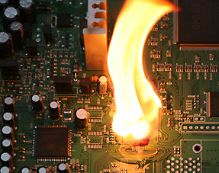
FLY-BACK CONVERTER INTERGRADED CIRCUIT BD7F100EFJ TSD OCP MOSFETS VIN,FB,COMP & SDX/EN CONCLUSION
MICHAILIDIS VICTOR

Slide 2

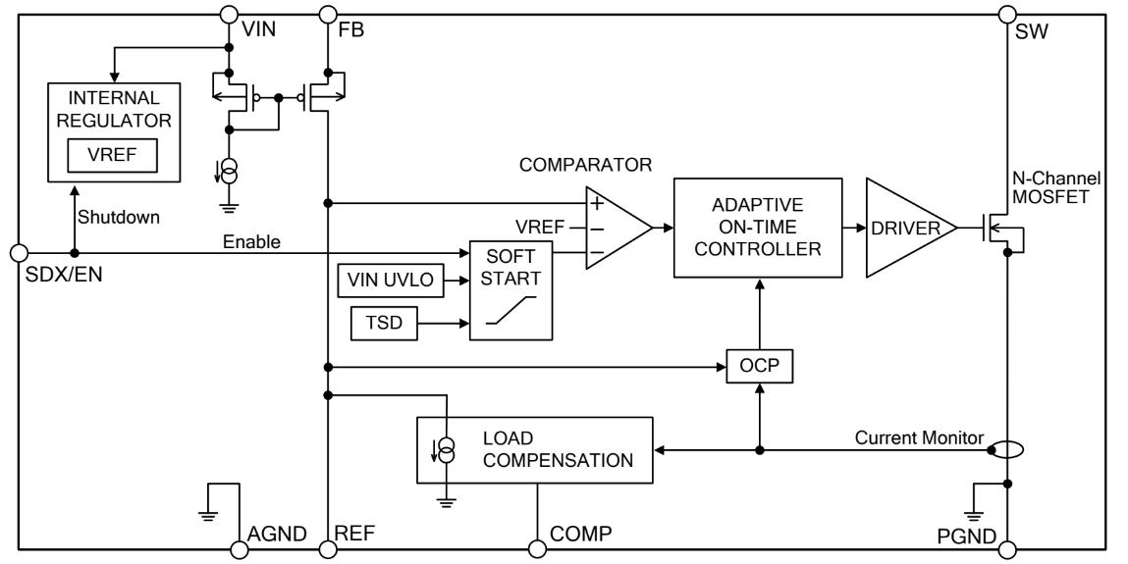
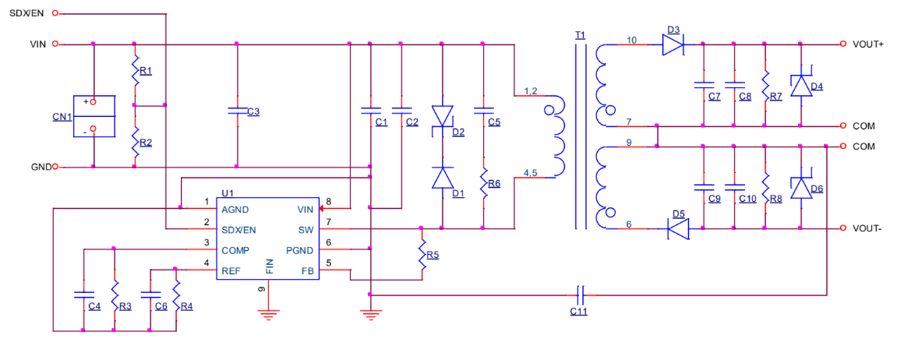
U1
In the final part of presentation, we will talk about the protection of the INTERGRADED CIRCUIT(U1) in FLYBACK CONVERTER and how the MOSFETs in VIN and FB work.
FLY BACK CONVERTER
Basic Principles of Power Electronics
Supervisor: Professor Nikolaos Papanikolaou

Slide 3
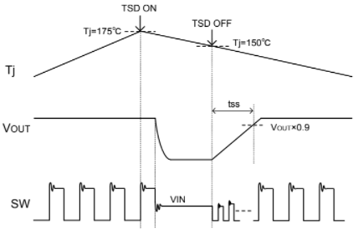
TSD (THERMAL SHUTDOWN )
This is the temperature protection block.
If the chip’s junction temperature, Tj, inside the IC is above 175°C (Typ), it will be detected and this block will be in the
protection state and the SW terminal becomes Hi-Z.
If Tj falls to below 150°C (Typ), it will return automatically through soft start.
Figure 1. TSD Timing Chart
Basic Principles of Power Electronics
Supervisor: Professor Nikolaos Papanikolaou

Slide 4
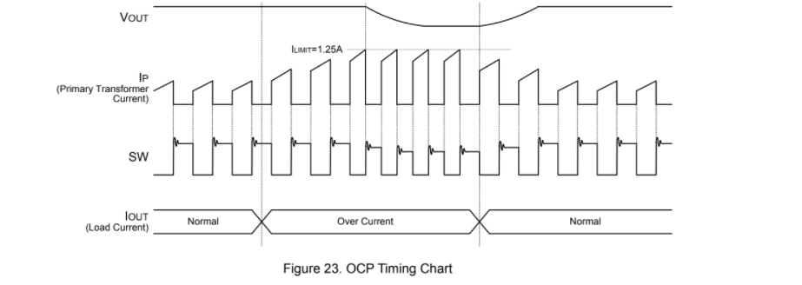
OCP ( OVER CURRENT PROTECTION )
This is the over-current protection block.If the peak current during the ON-Time of the built-in N-Channel MOSFET reaches 1.25A (Typ), it will be detected and theN-Channel MOSFET is turned OFF.If output voltage goes to 50% or less of the setting voltage, the peak detection current of OCP will be controlled by 0.625A(Typ).The min off time is 1.5μs (Typ) when the OCP is operated under the condition where the output voltage is 50% ofthe set voltage.
Figure 2. OCP Timing Chart
Basic Principles of Power Electronics
Supervisor: Professor Nikolaos Papanikolaou

Slide 5
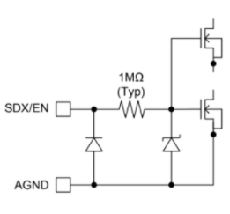
In u1 we have just a TSD in soft start.Generally the TSD contains a resistance(NTC), a Zener diode and n-chanel mosfets .
The input voltage generally decreases as the thermal resistance exacerbates.
This happens if we pass currents larger than what are the ideal.
As a result, thermistor fades and the zener diode increases the voltage thus forcing current to the MOSFETS to change in the saturation region until the charge is cut off.
Basic Principles of Power Electronics
Supervisor: Professor Nikolaos Papanikolaou

Slide 6
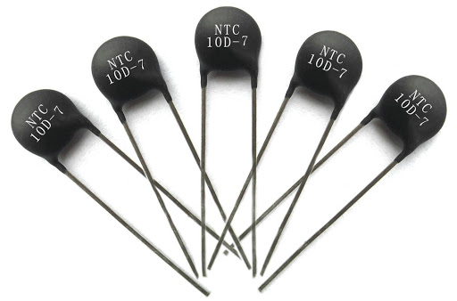
TSD’s THERMISTOR
The thermistor is a type of resistor, the value of which is affected by temperature, much more than in ordinary resistors (ohmic resistors).
NTCs, in which the resistance decreases as the temperature increases. Thus they can be used to deal with sudden surges due to surges. They are usually connected "in parallel" to the circuits, whenever a part of the current branches through them.
Basic Principles of Power Electronics
Supervisor: Professor Nikolaos Papanikolaou

Slide 7
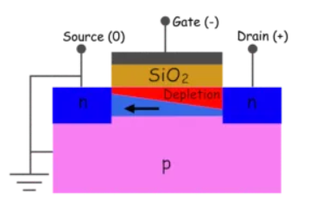
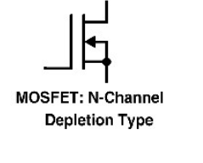
MOSFET N-CHANNEL
"Normally ON" and on the negative side of the load (common GND)
Basic Principles of Power Electronics
Supervisor: Professor Nikolaos Papanikolaou

Slide 8
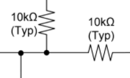
OCP contains n-resistance(typ) and N-Channel MOSFET who connected with them.
HOW IT WORKS:
If the current or voltage pass the limits that they have,
it will be detected throw the resistance(typ) because the MOSFET doesnt take the ideal voltage or current so the N-Channel MOSFET is turned OFF.
Basic Principles of Power Electronics
Supervisor: Professor Nikolaos Papanikolaou

Slide 9
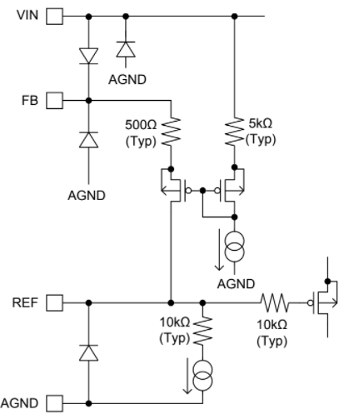
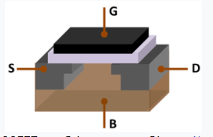
There we have three p-mosfets in VIN,in FB and in REF.
Basic Principles of Power Electronics
Supervisor: Professor Nikolaos Papanikolaou

Slide 10
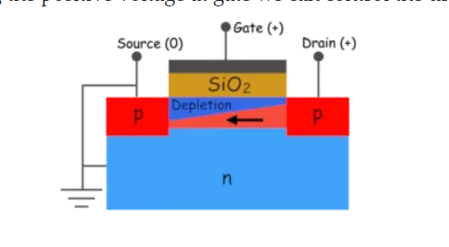
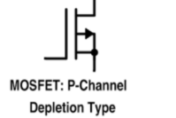
MOSFET P-CHANNEL
"Normally ON" and on the positive side of the load (common VCC)
Basic Principles of Power Electronics
Supervisor: Professor Nikolaos Papanikolaou

Slide 11
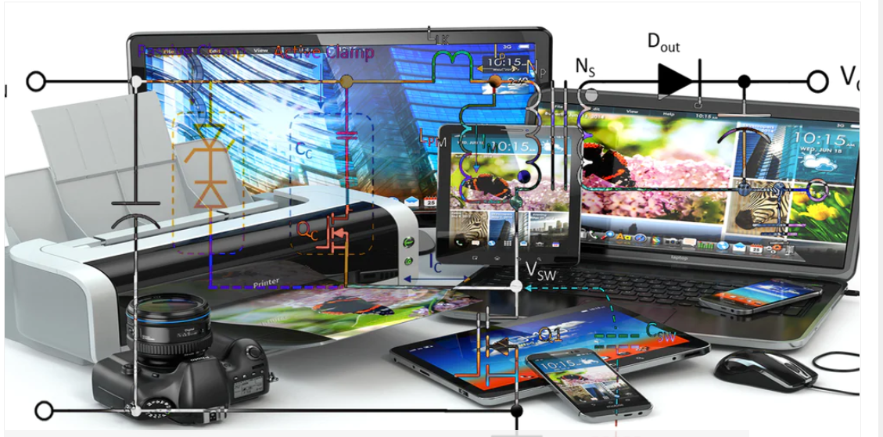
FLYBACK CONVERTER IN LIFE
Low-power switch-mode power supplies (cell phone charger, standby power supply in PCs)
Low-cost multiple-output power supplies (e.g., main PC supplies <250 W[citation needed])
High voltage supply for the CRT in TVs and monitors (the flyback converter is often combined with the horizontal deflection drive)
High voltage generation (e.g., for xenon flash lamps, lasers, copiers, etc.)
Basic Principles of Power Electronics
Supervisor: Professor Nikolaos Papanikolaou

Slide 12
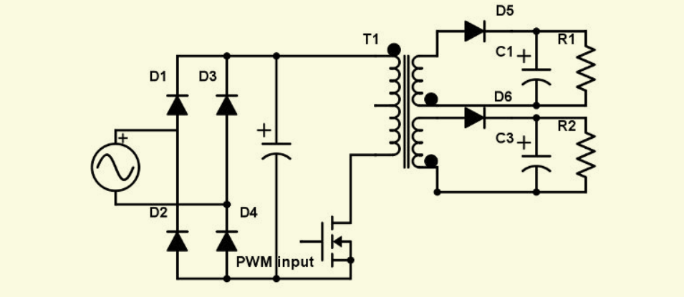
FLYBACK CONVERTER AC/DC
Basic Principles of Power Electronics
Supervisor: Professor Nikolaos Papanikolaou

Slide 13
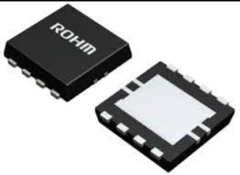
INTERGRADED CIRCUIT BD7F100EFJ

Slide 14
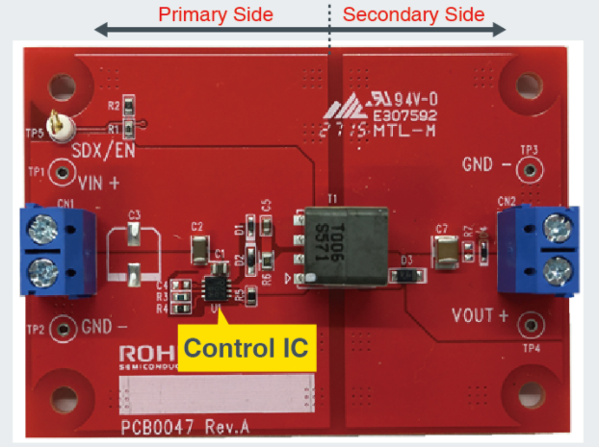
FLYBACK-CONVERTER

